Slide 1
MALL CUSTOMERS SEGMENTATION
CASE STUDY

Slide 2
Problem Statement
To study the customer profile coming to mall.
We try to solve this problem using Clustering technique.

Slide 3
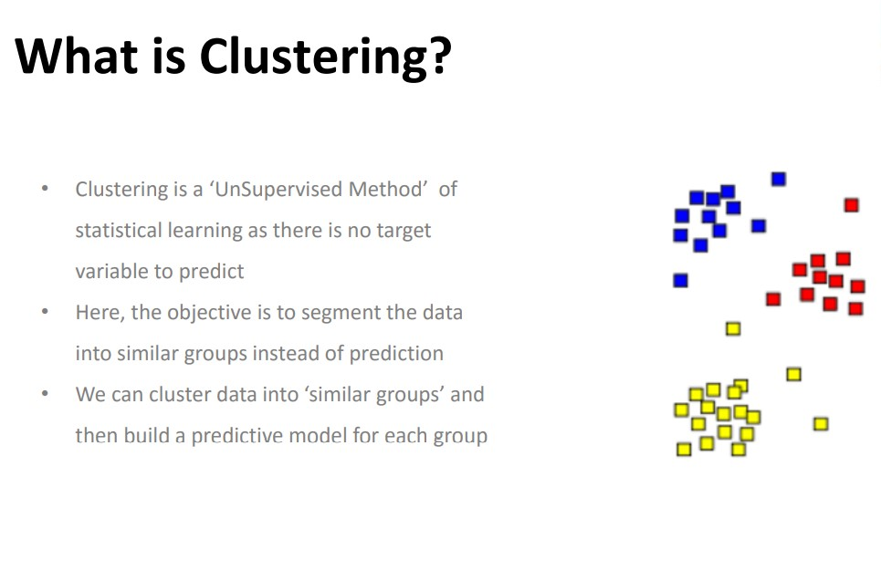
CLUSTERING

Slide 4
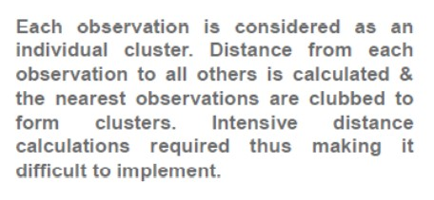
Hierarchical clustering
In hierarchical clustering distance from each observation is measured using Euclidean method

Slide 5
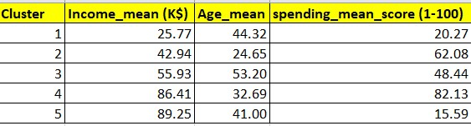
Mall Customers Cluster Profile

Slide 6
Insights
From the cluster profile we can get an insight that the customers between the age 32-41 have the highest income.
However even though the 41 age group customers earn the most but they spend the least as well.
The customers in the age group 24 to 32 spend more money.

